Slide 1
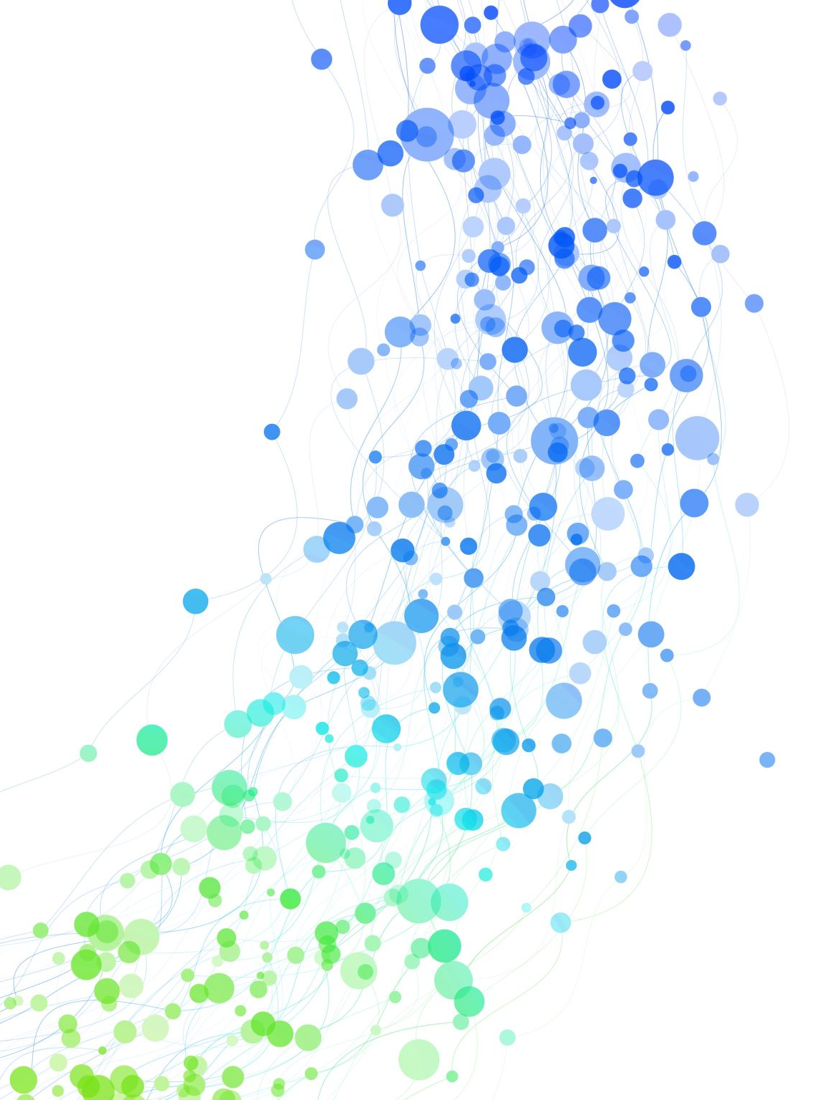
Using GitHub for Projects
Brief: Why GitHub?
Overview of GitHub Features
Real-world Application

Slide 2
Setting the Scene
Imagine creating a software for a company.
Team of 6-10 people.
Tasks distributed among team members.
Challenges: Tracking progress, tasks assignment, and version control.

Slide 3
Why GitHub?
Version Control Software (DVCS: Distributed Version Control System).
Work anywhere, anytime.
Branching not our focus, but a useful skill to showcase in future employment.

Slide 4
GitHub Features
Milestones: Helps track important phases in the project.
Issues: Record tasks, bugs, and ideas.
Assign tasks.
Monitor progress.
Tag related items.

Slide 5
GitHub in Practice
Scenario: Large scale project with many collaborators.
Using milestones to set due dates for features and bug fixes.
Default view: "is -issue, is - open"

Slide 6
Diving into Issues
Issues help track:What's completed.
Tasks remaining.
Quick glance at project progress.
Assignees: Know who's working on what.
Labels: Categorize the issue.

Slide 7
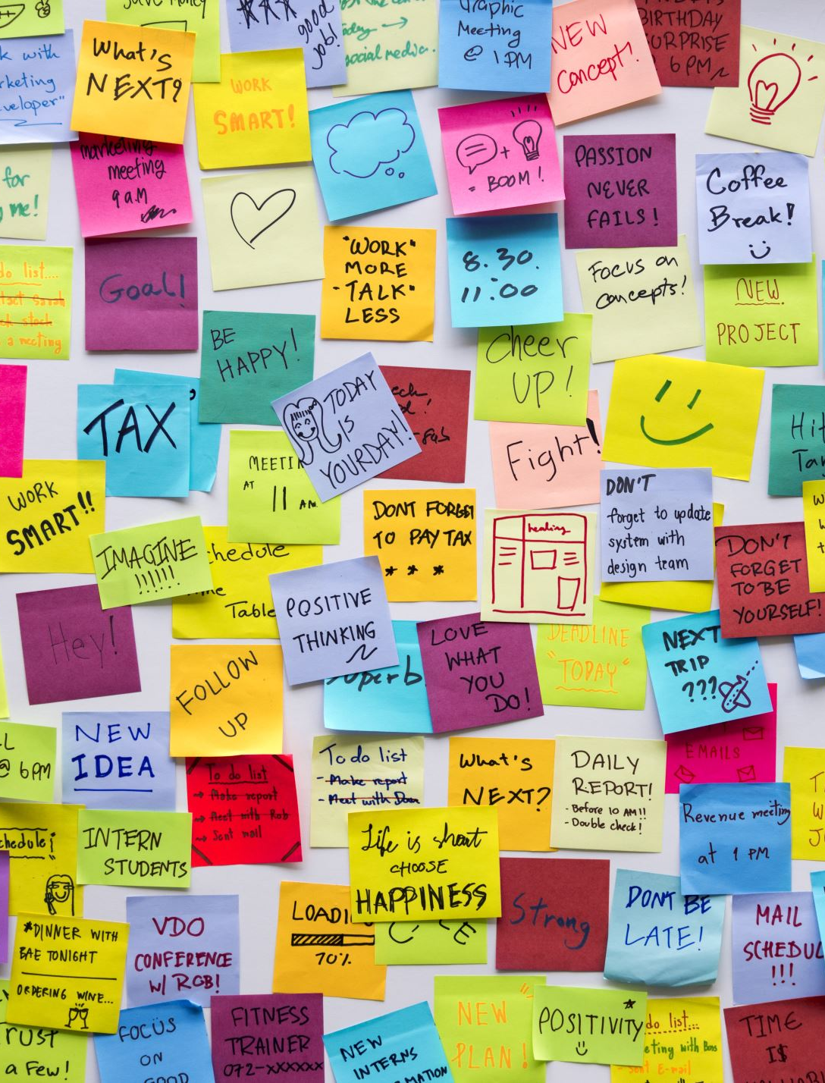
Show and Tell: Playlist Management
A quick overview of:
Project.
Issues.
Tasks.
Using milestones and labels.

Slide 8

Setting Up Your First Issue
Step-by-step guide:
Access 'Issues'.
Click 'Milestone'.
Set 'Title', 'Due Date', and optional 'Description'.
Assign, label, and submit.

Slide 9

Scenario
As a new developer, you are hired by "TechSolutions Inc." to develop an online store for a client. You will use GitHub to manage and track the development process.

Slide 10
Setting Up the Repository
You would create a new repository on GitHub for use with your project.
You would then clone the repository to your local machine using git clone.

Slide 11
Creating a Milestone: Frontend Development
In the GitHub repository, clicks on “Issues” and then “Milestones”.
Create a new milestone titled "Frontend Development" with a description and a due date.

Slide 12

Creating Issues Under Milestone
Under the “Frontend Development” milestone, create the following issues:
Design homepage.
Design product page.
Create shopping cart functionality.

Slide 13

Labeling Issues for Better Categorization
Create labels like "UI", "Backend", "Bug", and "Enhancement".
Please label "Design homepage" and "Design product page" as "UI".

Slide 14

Assigning Issues
Assign the homepage design issue to yourself.
As the team expands, you can assign other issues to new members.

Slide 15

Updating Issue with Tasks
Updates the "Design homepage" issue with the following tasks:
- [ ] Create a navigation bar.
- [ ] Design a banner section.
- [ ] List featured products.
NOTE: The “- [ ]” is used to create checkboxes

Slide 16

Working on the Tasks Locally
Starts designing the navigation bar. (We will just be creating a dumbing file)
Once completed, stage your changes with git add .
Commits your changes with a meaningful message using git commit -m "Designed navigation bar".
Pushes your changes to the online repository with git push.

Slide 17


Linking Commits to Issues
In your commit messages, include the issue number to link her commits to specific issues.
Edit the file so that we can create a new commit message

Slide 18

Monitoring Progress
You can check off completed tasks under the “Design homepage” issue.
You can see your progress on the milestone page, which shows percentage completion.

Slide 19

Resolving and Closing Issues
Once the homepage is fully designed, you can close the issue.
The progress bar in the "Frontend Development" milestone updates accordingly.

Slide 20

Review and Collaboration
If Bob joins the team and has suggestions, he can comment on issues or open new ones.
Bob and you can review each other's code via "Pull Requests".

Slide 21
Handling Bugs and Feedback
Post-launch, a user reports a bug in the shopping cart.
You can now open a new issue, label it as "Bug,” and assign it to Bob.
Bob fixes the bug, commits his changes, links the commit to the issue, and then closes the issue once resolved.

Slide 22

Wrapping Up
By the end of this project, "TechSolutions Inc." has a transparent history of the entire "OnlineStore" development process on GitHub, showcasing all milestones, tasks, collaborations, and resolutions.

Slide 23

Resolve merge conflicts
Moodle -> DVCS -> Use this link to do the merge conflict DVCS tutorial
Merge conflicts happen when two people make changes to the same file on GitHub—a common occurrence when you’re working with others. While resolving differences might involve some discussion, merge conflicts don’t have to be scary. This course guides you through the steps to finding the best merge conflict solution, so your team can keep building.
Who is this for: New developers, new GitHub users, users new to Git, students, managers, teams.
What you'll learn: What merge conflicts are, how you resolve merge conflicts, how to reduce merge conflicts.
What you'll build: We'll work with a short Markdown resume file in this course.
Prerequisites: We recommend taking Introduction to GitHub prior to this course.
How long: This course takes less than 30 minutes to complete.

